Slide 1



.NET 6 App Architecture for Kubernetes
Part 1 : Hosting & Application Lifecycle
@mmisztal1980
45m
Notes:
Kubernetes is the leading container orchestrator
trends.gogle.com

Slide 2
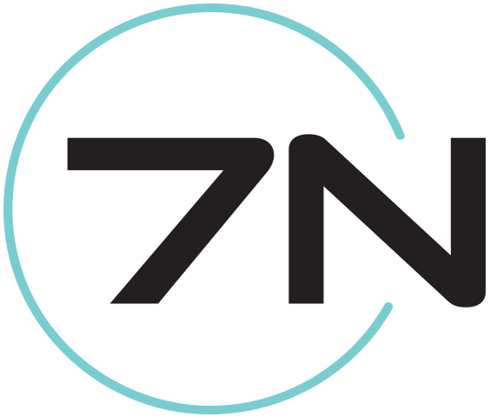




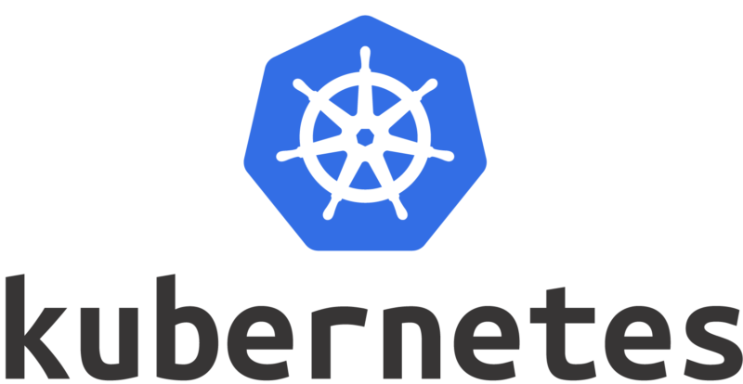

@mmisztal1980

Slide 3

What’s new in app hosting?

Slide 4
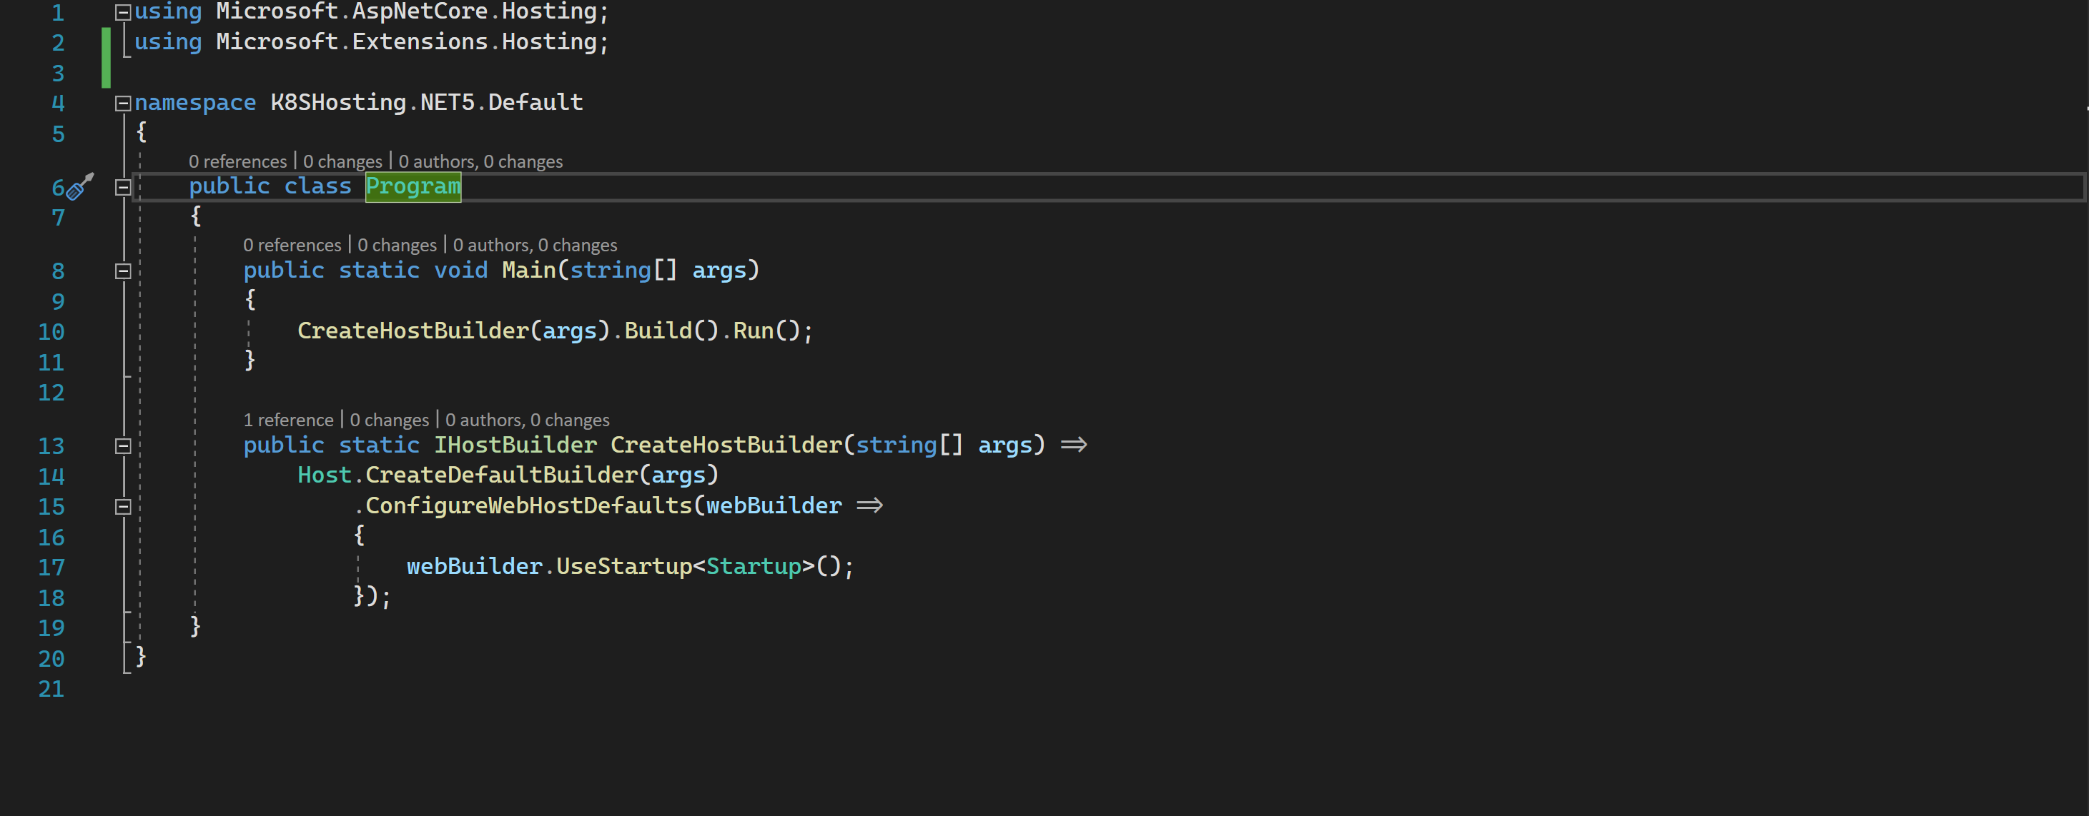
Program.cs (.NET5)

Slide 5
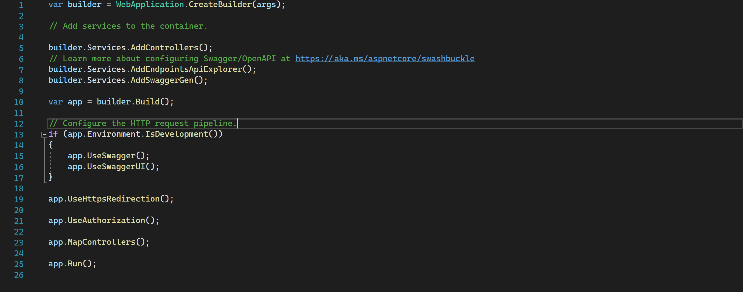
Program.cs (.NET6)

Slide 6
Hosting API Evolution

Slide 7
.NET Core 2.x: WebHost.CreateDefaultBuilder() .NET Core 3.x / .NET 5: Host.CreateDefaultBuilder() .NET 6: WebApplication.CreateBuilder()

Slide 8
WebApplication.CreateBuilder() ?
// Create the WebApplicationBuilder var builder = WebApplication.CreateBuilder(args);
// Configure the application and DI container registrations builder.Services.AddControllers();
builder.Services.AddSingleton<MySingletonService>();
builder.Logging.AddConsole(); // Start building the pipeline var app = builder.Build(); app.UseStaticFiles();
app.UseMiddleware<MyMiddleware>();
app.MapControllers();
app.Run(); // <-- RunAsync supported too, no CancellationToken ?!?
https://andrewlock.net/exploring-dotnet-6-part-2-comparing-webapplicationbuilder-to-the-generic-host/

Slide 9
Do we have to use the new API?

Slide 10
Kubernetes integration: Probes

Slide 11
Startup Probe I need a long time to start… Liveness Probe I’m alive – please don’t kill me Readiness Probe I’m ready to receive traffic
https://kubernetes.io/docs/tasks/configure-pod-container/configure-liveness-readiness-startup-probes/

Slide 12
ports:
name: liveness-port
containerPort: 8080
hostPort: 8080 startupProbe:
httpGet:
path: /healthz
port: liveness-port
failureThreshold: 30
periodSeconds: 10
livenessProbe:
httpGet:
path: /healthz
port: liveness-port
failureThreshold: 1
periodSeconds: 10
https://kubernetes.io/docs/tasks/configure-pod-container/configure-liveness-readiness-startup-probes/

Slide 13
Handling long starting services?

Slide 14
ASP.NET Core does not support this out of the box – does it?
https://andrewlock.net/running-async-tasks-on-app-startup-in-asp-net-core-3/

Slide 15
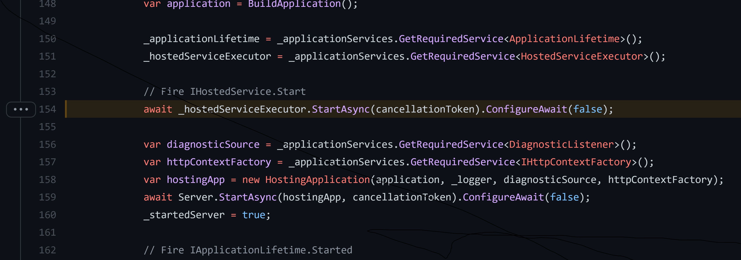
Changes made in ASP.NET Core 3.x

Slide 16
Kubernetes integration: Shutdown
https://bit.ly/3qPtnJn

Slide 17
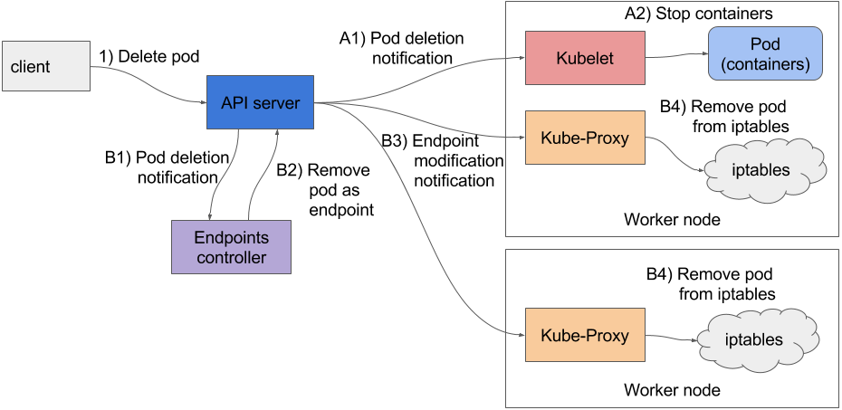
https://freecontent.manning.com/handling-client-requests-properly-with-kubernetes/

Slide 18
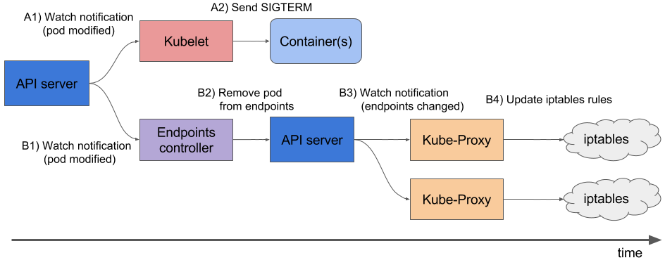
https://freecontent.manning.com/handling-client-requests-properly-with-kubernetes/

Slide 19
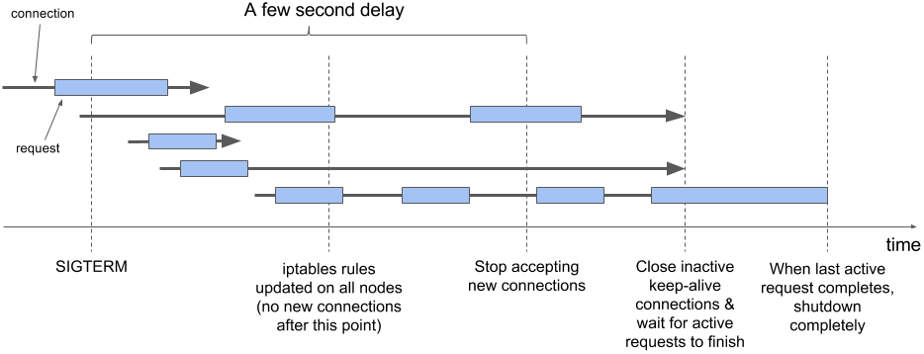
https://freecontent.manning.com/handling-client-requests-properly-with-kubernetes/

Slide 20
WebApplication.CreateBuilder() ?
appLifetime.ApplicationStopping.Register(() => {
Thread.Sleep(10000);
}); // Is this really the best way ?!?
https://blog.markvincze.com/graceful-termination-in-kubernetes-with-asp-net-core/

Slide 21

lifecycle:
prestop:
exec:
command:
- sh
- -c
- “sleep 5”
https://kubernetes.io/docs/tasks/configure-pod-container/configure-liveness-readiness-startup-probes/

Slide 22
ports:
name: liveness-port
containerPort: 8080
hostPort: 8080 startupProbe:
httpGet:
path: /healthz
port: liveness-port
failureThreshold: 30
periodSeconds: 10
livenessProbe:
httpGet:
path: /healthz
port: liveness-port
failureThreshold: 1
periodSeconds: 10
https://freecontent.manning.com/handling-client-requests-properly-with-kubernetes/

Slide 23
What do we really need?

Slide 24
Standardized pipeline & behavior irregardless of workload type

Slide 25
Liveness
Middleware
Metrics
Middleware
Startup Middleware
Readiness
Middleware
HealthCheck Middleware
Authorization
Middleware
Request
Handler

Slide 26

DEMO

Slide 27
Q&A ?

Slide 28

THE END
@mmisztal1980

